Slide 1
Interfacing of ESP8266 with Beaglebone Black Project : Car Over-speed detection system
SUBMITTED BY:
Sunny Devgan (C0752045)
Group #4

Slide 2
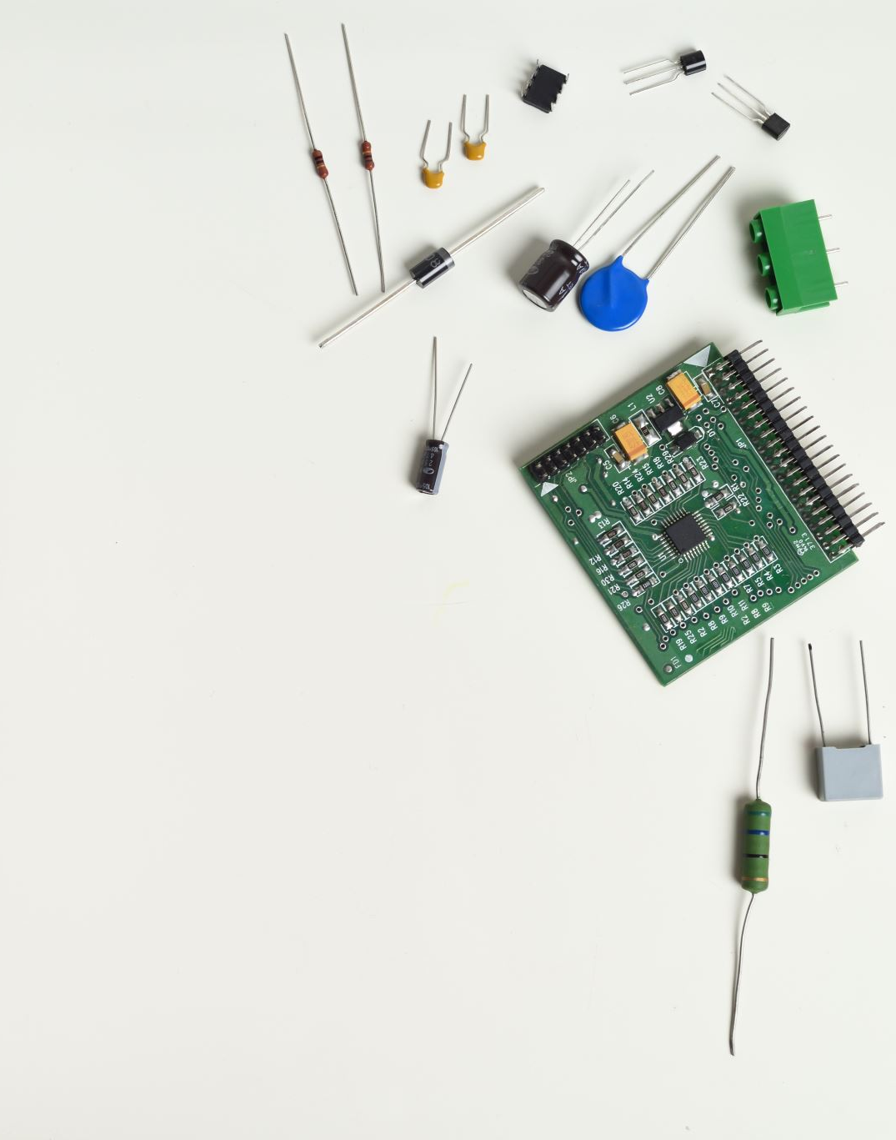
Contents
Block Diagram of project
Software and hardware used in interfacing ESP8266
Introduction of ESP8266
Connection of ESP8266 with Arduino IDE
Coding ESP8266 in Arduino IDE
Output in Arduino IDE
Connection details
Connection of ESP8266 with Beaglebone Black
Coding in putty
How to use psftp
Output in putty
References.

Slide 3
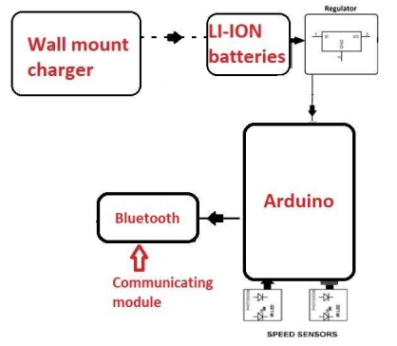
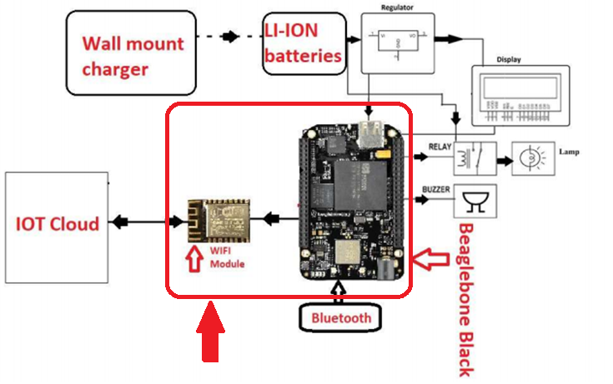
Introduction of Arduino
Block Diagram of project

Slide 4
Software and hardware used in interfacing ESp8266
Hardware used
ESP8266 (WIFI)
Beaglebone Black
Jumper cables
USB cables
Software Used
Eclipse IDE
Arduino IDE
Putty
Nano Editor
GCC compiler

Slide 5
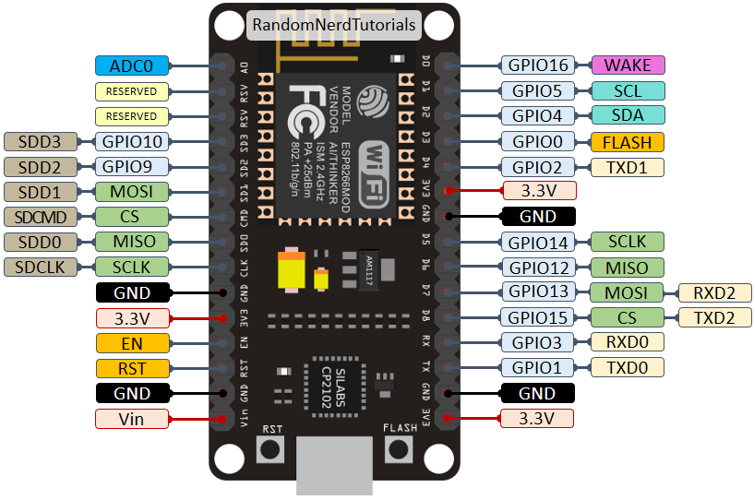
Introduction of ESP8266
The operating voltage for this board is 3.3V
There are 16 GPIO line available some of them are used internally for devices like flash memories
2 pins out of 11 GPIO are reserved for the are reserved for communication Rx and Tx pins
D0 to D8, total 9 pins are used as GPIO pins.
SD1, CMD, SD0, CLK are four pins for SPI communication.
Two buttons are present on the board for flashing the device and reset.

Slide 6
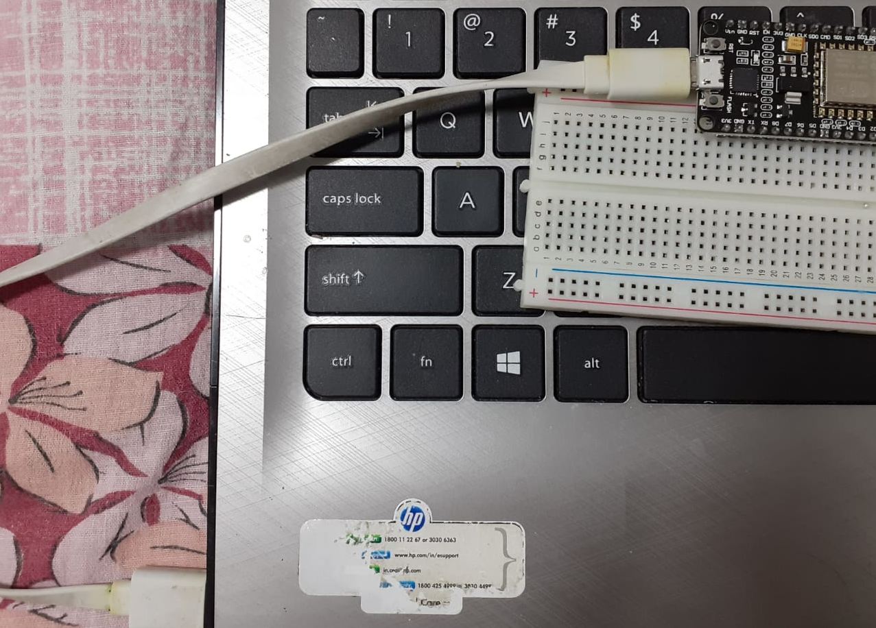
Connections of ESP8266 with Arduino IDE
ESP8266 is connected to Arduino IDE with the help of micro-USB cable.
No jumper wires required for this connection
No separate power supply required because ESP8266 gets power via USB cable.

Slide 7
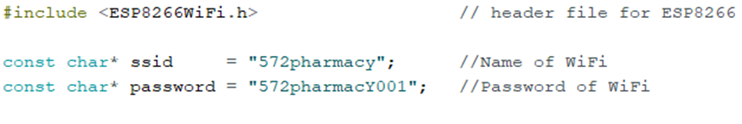
Coding ESP8266 in Arduino IDE
Added a header file called ESP8266WiFi.h by installing the drivers of ESP8266 in Arduino IDE.
Initializing WIFI name as 572pharmacy
Initializing password as 572pharmacY001

Slide 8
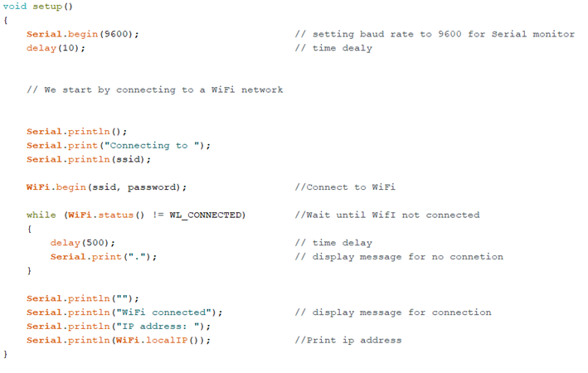
Coding ESP8266 in Arduino IDE (cont.d)
Setting up the serial monitor
Baud rate is set to the 9600
The setup consists of the connecting the Wi-Fi network
It prints the IP address
Inside the while loops we are checking if the WI-FI is connected or not connected
If the network is not connected it prints ……….
And when the network gets connected it says WI-FI connected also shows the IP address

Slide 9
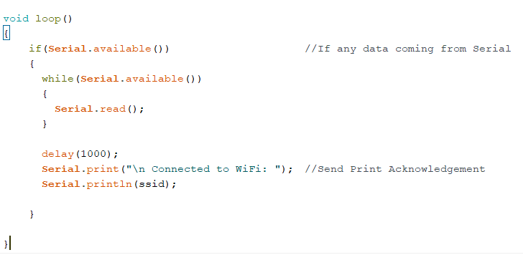
Coding ESP8266 in Arduino IDE (cont.d)
We used endless void loop to check is there any data coming from the Beaglebone side or not.
Serial.available () is used to check the data coming.
We took time delay before printing the message “ connected to WiFi” along with the ssid.

Slide 10
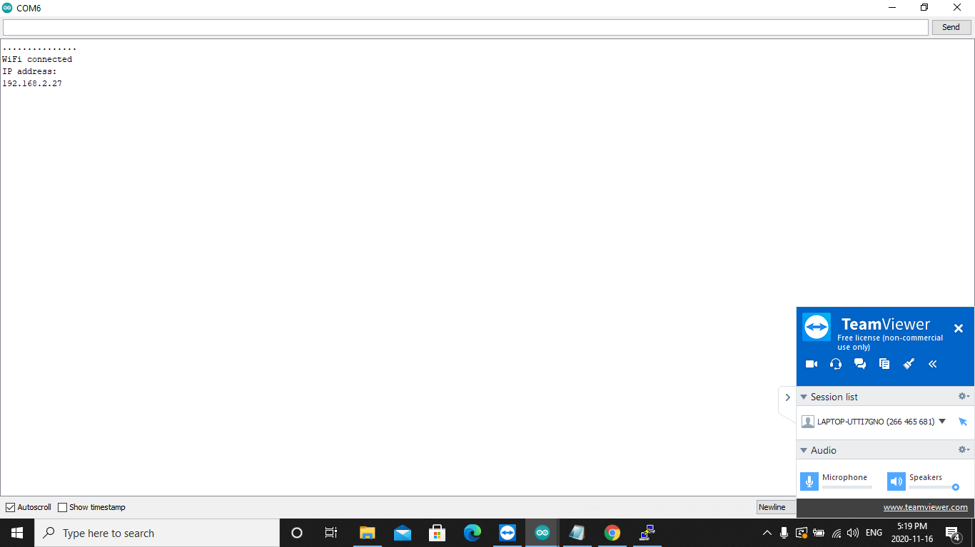
Output in Arduino IDE

Slide 11
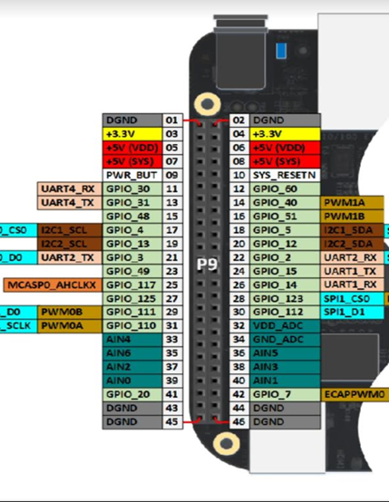
Connection details
Pin 18 Tx of ESP8266 is connected to UART1 pin 9 26 of Beaglebone Black
Pin 19 Rx of ESP8266 is connected to UART1 pin 9 24 of Beaglebone Black
GND pin is connected to GND and Vin is connected 3.3V

Slide 12
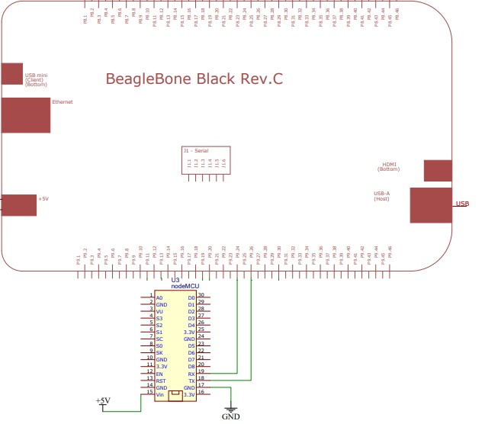
Connections of ESP8266 with Beaglebone Black
Pin 18 and pin 19 which are Tx and Rx pins of ESP8266 are connected to the p9 24 and p9 26 pins of Beaglebone black.
UART 1 pins of Beaglebone Black are used for communication with ESP8266.
Pin 17 and pin 15 of ESP8266 are connected to GND and 3.3v respectively.

Slide 13
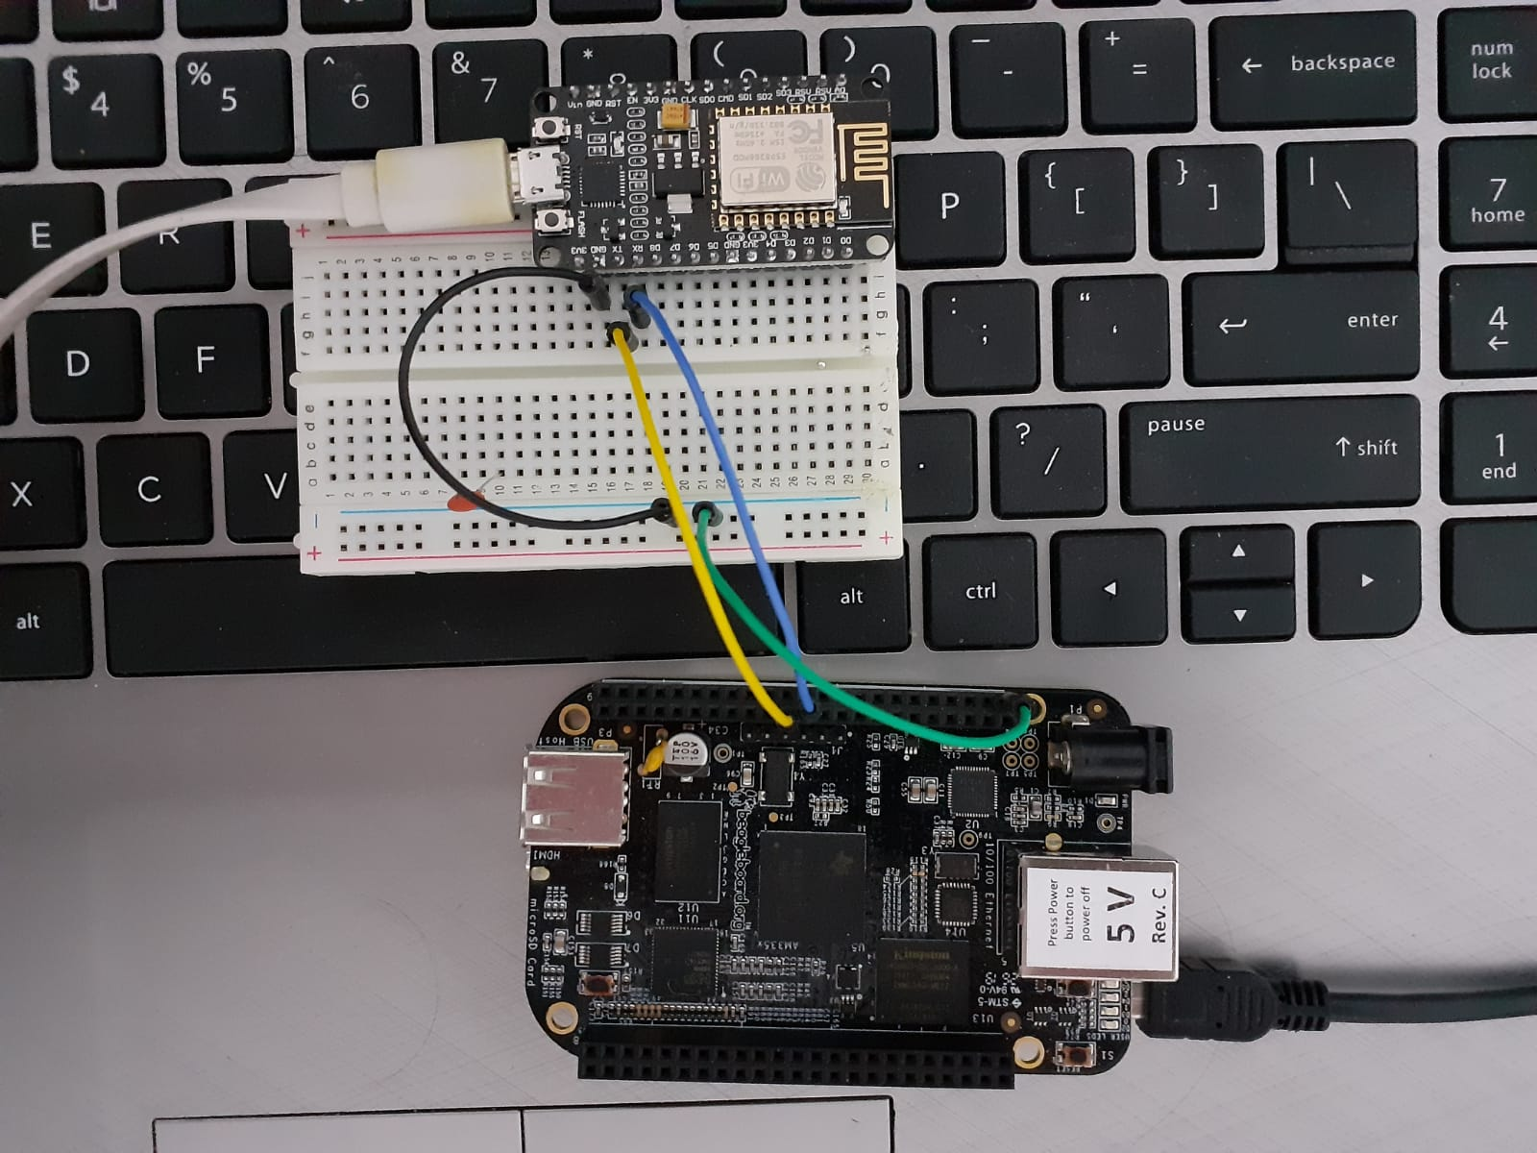
Connections of ESP8266 with Beaglebone

Slide 14
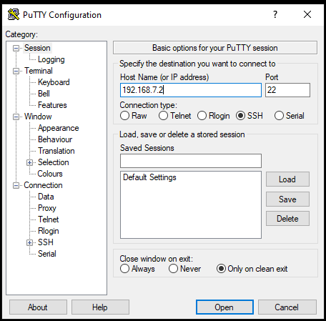
Coding of Beaglebone Black in Putty
This is the PuTTY configuration page (starting page).
We have to entre the IP address of our Beaglebone Black
IP address is 192.168.7.2
Then click on the open.

Slide 15
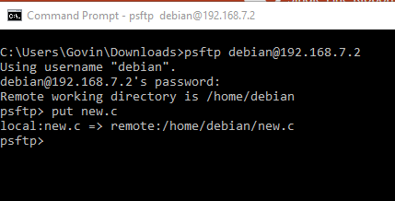
How to use PSFTP
This is how to add file to Beaglebone from host machine
We need to download PSFTP.exe and open cmd in windows
Use command “psftp Debian@192.168.7.2”
Pasword is same “temppwd”
To add the file (new.c) the command is “put new.c”

Slide 16
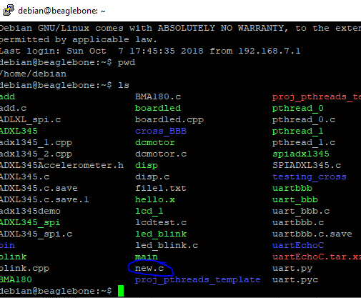
How to use PSFTP (cont.d)
You can check file by using putty
For checking all the files we need the command “ls” to show all the file

Slide 17
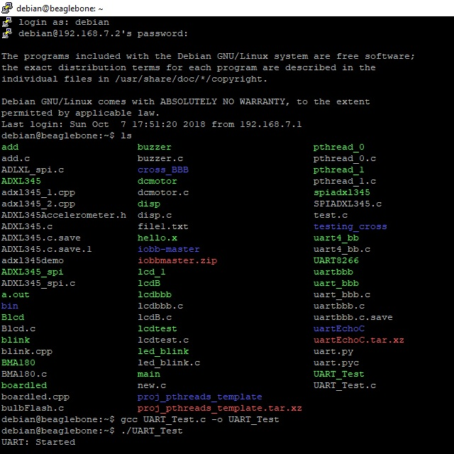
Coding of Beaglebone Black in Putty (cont.d)
We have to enter Debian as login and password is temppwd
The next command is “ls” to see all the files.
Our file is UART_Test.c
To open the file we used command “nano UART_Test.c”
Next command is “gcc UART_Test.c o UART_Test” to compline the program.
“./ UART_Test.c” to run the file.

Slide 18
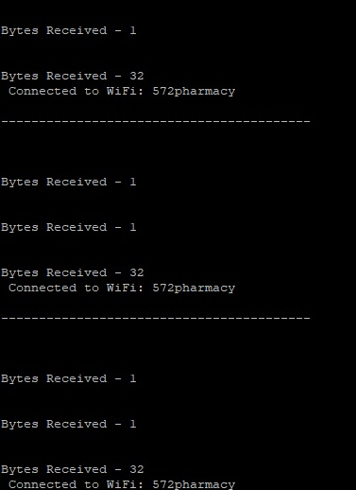
Output in Putty

Slide 19
REFERENCES
How to program NodeMCU with Arduino IDE. (2019, February 7). Retrieved from https://www.youtube.com/watch?v=flLMMHCNkQE
NodeMCU GPIO Arduino IDE. (n.d.). Retrieved from https://www.electronicwings.com/nodemcu/nodemcu-gpio-with-arduino-ide
Serial ports/ UART. (n.d.). Retrieved from http://beaglebone.cameon.net/home/serial-ports-uart
How to get UART serial ports working on the beaglebone black. (2018, February 9). Retrieved from https://electronics.trev.id.au/2018/02/09/get-uart-serial-ports-working-beaglebone-black/

Slide 20
REFERENCES
NodeMCU GPIO with Arduino IDE. (n.d.). Retrevied from https://www.electronicwings.com/nodemcu/nodemcu-gpio-with-arduino-ide
NodeMCU ESP8266. ( 2020, April 22). Retrieved from https://components101.com/development-boards/nodemcu-esp8266-pinout-features-and-datasheet
NodeMCU Documentation. (n.d.). Retrieved from https://nodemcu.readthedocs.io/en/release/

